Slide 1

Exploring Stock Market Strategies with Risk and Influence with Complex Networks
Rachael Judy, Connor Klein, Josh Smith
Notes:
12 minute presentation

Slide 2
Project Motivations and Objectives
Notes:
This project was designed with the objective of exploring the impact of risk as defined by a power law distribution and networked brokers in the context of neighbor influence on the brokers' portfolio values over different trading intervals. Economic markets are volatile and have been shown to contain many fat-tailed and power law distributions, such as in growth rates and stock returns \cite{gabaix_powerlaws}. Many different models of the market have been created to explore these behaviors, and data is readily available to examine the impacts of different strategies and inter-dependencies on the market. Scholars have examined risk and risk aversion, explored modeling the market as a network of stocks or brokers, attempted to classify and group the networks, and attempted to design models of crashes that resemble the real world. This project combines the study of risk in psychology with the fat tailed distribution of network connections and the volatility of black swan \cite{taleb_antifragile} events to evaluate market broker strategies to maximize portfolio value over typical events and through drastic changes in the market. \section{Background}\label{sec:background} % Background: Summary of important concepts and related previous work (with citations). This topic has been explored from a variety of perspectives. Most work has been divided into exploring financial markets in terms of complex networks, looking at individuals' perspective on risk, and running case studies with different clustering and strategies in the market. The work in complex networks creates networks with either brokers or stocks at nodes \cite{baydelli_hierarchicalmarket,kulmann_marketscomplexsystems,dimaggio_relevancebrokernetworks}. To create the edges, they have explored the diffusion of information \cite{dimaggio_relevancebrokernetworks}, spread of first and rebound shocks \cite{gai_contagion}, and correlation and mutual information of different stocks \cite{li_correlation, fiedor_networksmutualinformationrate}. This study models the market with brokers at the nodes with influence connecting the brokers. Further, several models for risk were presented. This involved quantifying the risk with the Chen, Roll, and Ross factors \cite{cooper_realinvestmentandrisk} to predict economic activity, assessing the importance of the distribution of risk aversion in the volatility of returns \cite{lansing_riskaversion}, and highlighted the importance of dividends in quantifying the risk level of stocks. These models provide a basis for developing a model of portfolio risk. Based on the ideas presented in Taleb's book \cite{taleb_antifragile}, it has been suggested that some strategies which perform best over typical market moves may not be optimal during sudden volatile events, which characterize the stock market. The idea that these strategies based on risk with the input on risk assessment from neighbors could be what differentiates the quality of the strategies.
The exploration of the market was designed as a simulation to be run over various time intervals for interconnected brokers that can influence one another and preferred risk levels. This included creating 100 brokers each with a preferred risk level and a number of friends sampled from a power law distribution. The friends also provided their assessment of risk for a given stock which was considered by the broker in their personal assessment. Data for every day in the interval was fed into the simulation, allowing brokers, in a random order, to buy or sell stocks to maintain their preferred level of risk. For interpretation of results, the brokers' indices correspond to the level of preferred risk. Running the simulation over 2003-2012 allows examining the results of strategies both in normal operating and in a drastic events such as the 2007-2008 financial crisis.

Slide 3
Key Elements: Influence
Notes:
Add graph of brokers

Slide 4
Key Elements: Risk
Notes:
Add plots showing how high risk ends up with low liquidity, high dollar value of stocks, fewer stocks

Slide 5
Results: Risk

Slide 6
Results: Risk

Slide 7
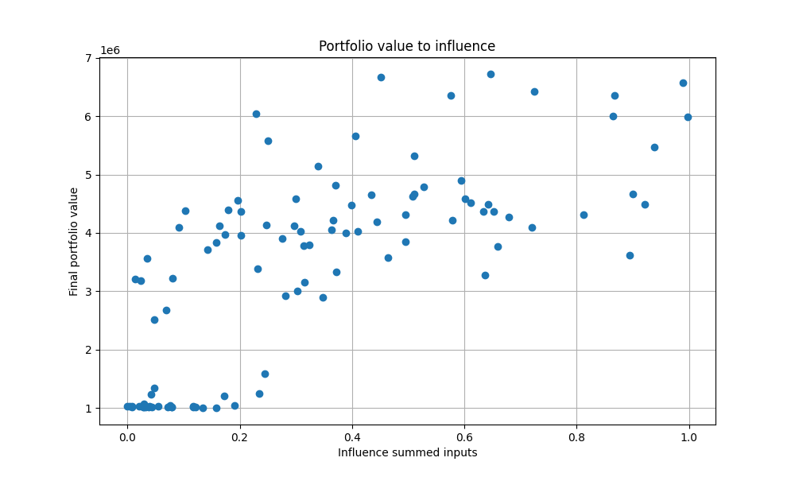
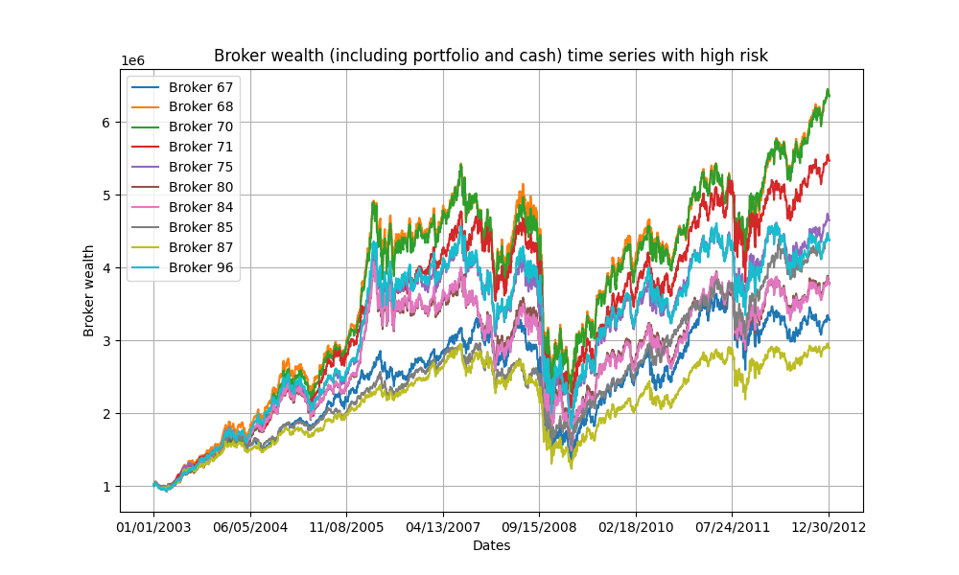
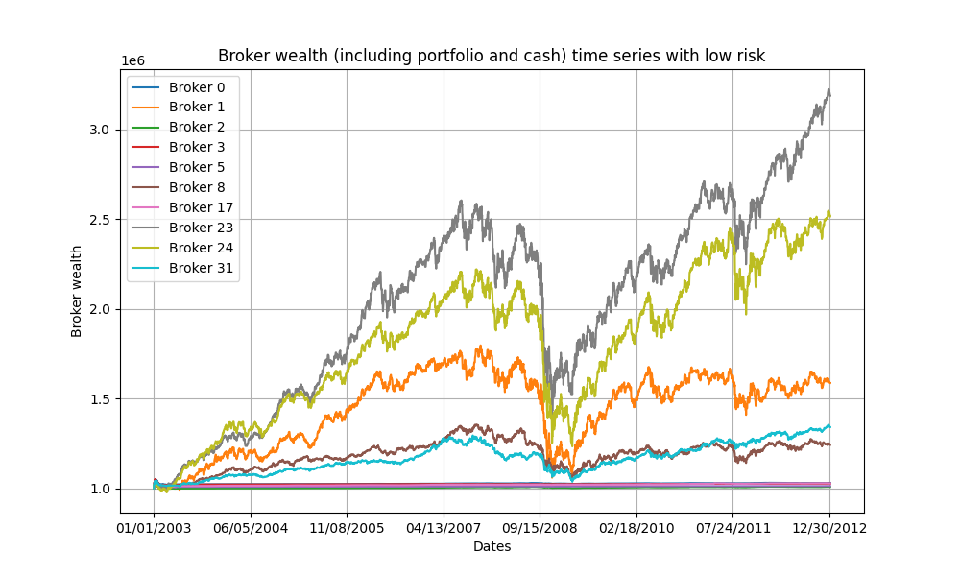
Results: Influence

Slide 8
Highlights of Results

Slide 9
Challenges and Future Work
Notes:
\section{Conclusion}\label{sec:conclusion} % Conclusion: Summary of accomplishments, challenges and open issues This project explored the value of different risk strategies in a simulated market of networked brokers with power law assumptions for risk and connectivities between brokers. It demonstrated the value of taking some input from neighbors' assessments on risk to filter which stocks are actually performing well and showed ... % highlight benefits of risk \subsection{Future Work}\label{subsec:futurework} Given the scope of time for the project, only limited aspects of market strategies could be explored. One open area in which limited advances were made was exploring the impact of the influence of neighbors' assessment of risk on the success of a strategy. Because all neighbors used the same information and formula, except for the accounting of their personal status, the impact of influence could be expanded. Further, the risk assessment would be modified to vary more between brokers based on partial information and stocks without full information available to better represent the real world and better account for the interconnections between stocks.

Slide 10
References
X. Gabaix, “Power laws in economics: an introduction,” \textit{Journal of Economic Perspectives}, vol. 30, no. 1, pp. 185–206, Feb. 2016.
N. N. Taleb, Antifragile: Things that gain from disorder. Harlow, England: Penguin Books, 2013.
D. Easley and J. Kleinberg, Networks, crowds, and markets: Reasoning about a highly connected world. Cambridge, England: Cambridge University Press, 2012.
C. Hommes, “Behavioral and Experimental Macroeconomics and Policy Analysis: A Complex Systems Approach,” Journal of Economic Literature, vol. 59, no. 1, pp. 149–219, Mar. 2021, doi: 10.1257/jel.20191434.
C. K. Tse, J. Liu, and F. C. M. Lau, “A network perspective of the stock market,” Journal of Empirical Finance, vol. 17, no. 4, pp. 659–667, Sep. 2010, doi: 10.1016/j.jempfin.2010.04.008.
M. Kuhlmann, "Explaining financial markets in terms of complex systems," \textit{Philosphy of Science}, vol. 81, no. 5, pp. 1117-1130, Dec. 2014. %doi: 10.1086/677699.
M. Di Maggio, F. Franzoni, A. Kermani, and C. Sommavilla, "The relevance of broker networks for information diffusion in the stock market," \textit{Journal of Financial Economics}, vol. 134, no. 2, pp. 419-446, Nov. 2019.
P. Gai and S. Kapadia, "Contagion in financial networks," \textit{Proceedings of the Royal Society}, vol. 466, no. 2120, pp. 2401–2423, Aug. 2010.
C. K. Tse, J. Liu, and F. C. M. Lau, “A network perspective of the stock market,” \textit{Journal of Empirical Finance}, vol. 17, no. 4, pp. 659–667, Sep. 2010. % doi: 10.1016/j.jempfin.2010.04.008.
G. Li, A. Zhang, Q. Zhang, D. Wu, and C. Zhan, “Pearson correlation coefficient-based performance enhancement of broad learning system for stock price prediction,” \textit{IEEE Transactions on Circuits and Systems II: Express Briefs}, vol. 69, no. 5, pp. 2413–2417, May 2022.
P. Fiedor, “Networks in financial markets based on the mutual information rate,” \textit{Physical Review E}, vol. 89, no. 5, May 2014. % doi: 10.1103/PhysRevE.89.052801.
I. Cooper and R. Priestley. "Real investment and risk dynamics," \textit{Journal of Financial Economics}, vol. 101, no. 1, pp. 182-205, July 2011.
K. J. Lansing and S. F. LeRoy, “Risk aversion, investor information and stock market volatility,” \textit{European Economic Review}, vol. 70, pp. 88-107, July 2014.
J. E. Corter and Y. J. Chen, “Do investment risk tolerance attitudes predict portfolio risk?,” \textit{Journal of Business and Psychology}, vol. 20, no. 3, pp. 369-381, 2006.
D. Harmon, B. Stacey, Y. Bar-Yam, and Y. Bar-Yam, "Networks of economic market interdependence and systemic risk," New England Complex Systems Institute, Cambridge, MA, Tech. Report 1011.3707, Mar. 2009.
Y. Y. Baydilli, S. Bayir, and I. Tuker, “A hierarchical view of a national stock market as a complex network,” \textit{Economic Computation \& Economic Cybernetics Studies \& Research}, vol. 51, no. 1, pp. 205–222, Jan. 2017.

